Slide 1


Titolo presentazione sottotitolo
Improved Verification of Networks of Timed Automata
Milano, XX mese 20XX
Robert Lawrence Smith
Supervisor: Prof. Pierluigi San Pietro
Cosupervisors: Prof. Matteo Rossi,
Prof. Marcello Bersani

Slide 2
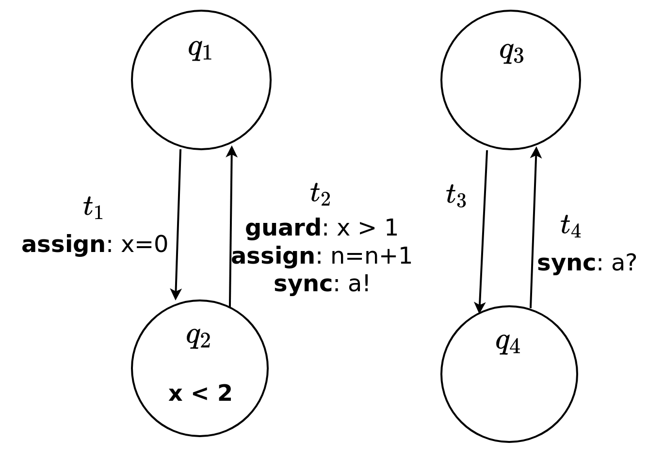
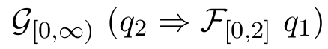
Networks of Timed Automata
Useful model for real-time systems
Transitions can depend upon real-valued clocks and integer variables
MITL used to encode property to verify

Slide 3
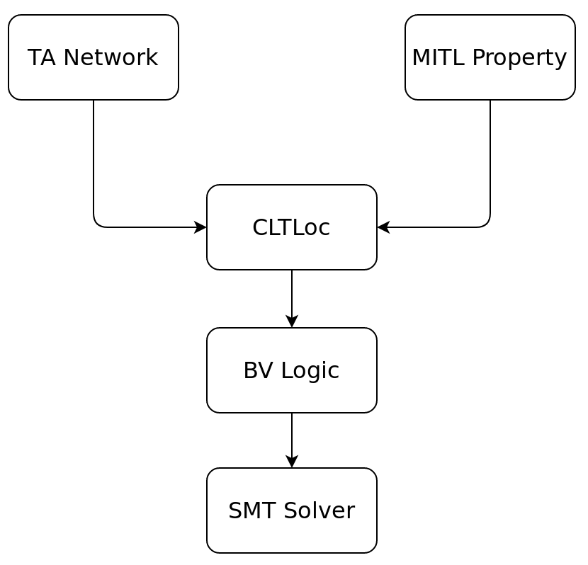
Bounded Model Checking - TACK
Verify given property over TA network
Linear Temporal Logics offer powerful continuous semantics
Network and Property converted into CLTLoc before solving
“Lasso” shape allows for finite representation of infinite traces

Slide 4
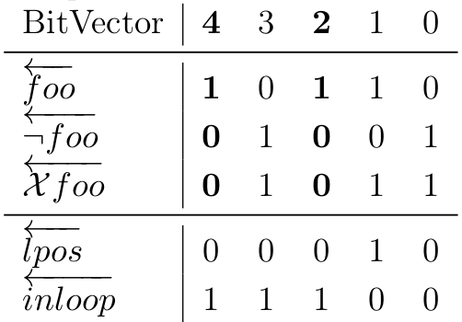
Improving TACK
CLTLoc is an inefficient intermediary
Directly target SMT language
Remove unnecessary CLTLoc semantics

Slide 5
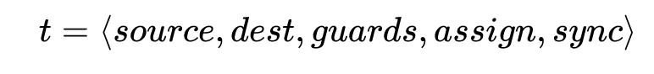
Improving TACK (cont.)
Removal of unnecessary state Bit-Vectors
Full arithmetic supported for integer variables
Fixed flaw in synchronization logic

Slide 6
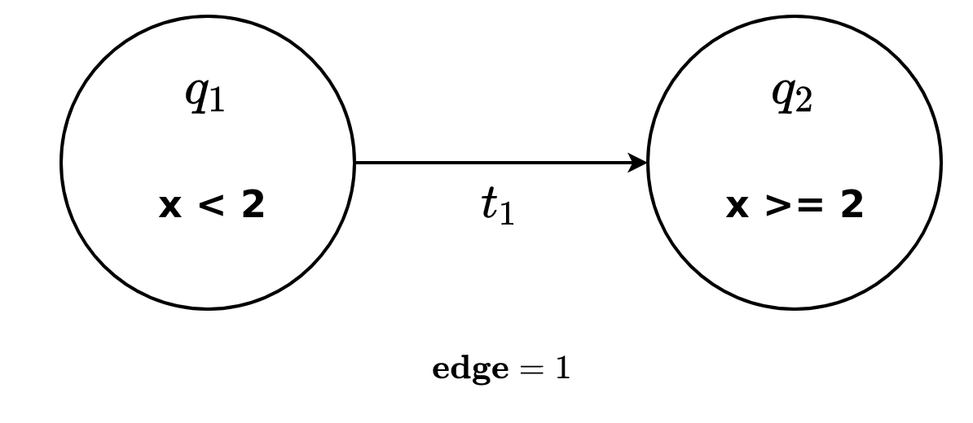
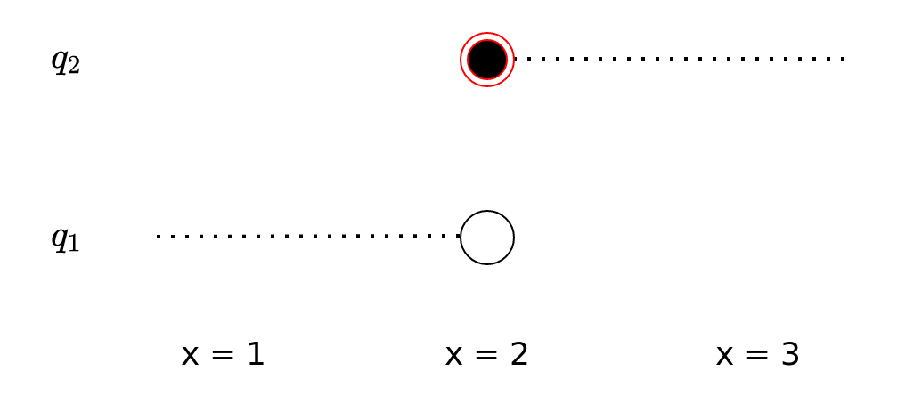
Constraints: Transitions
TA must be in exactly one location at the moment of transition
Allows for more flexibility with state invariants

Slide 7
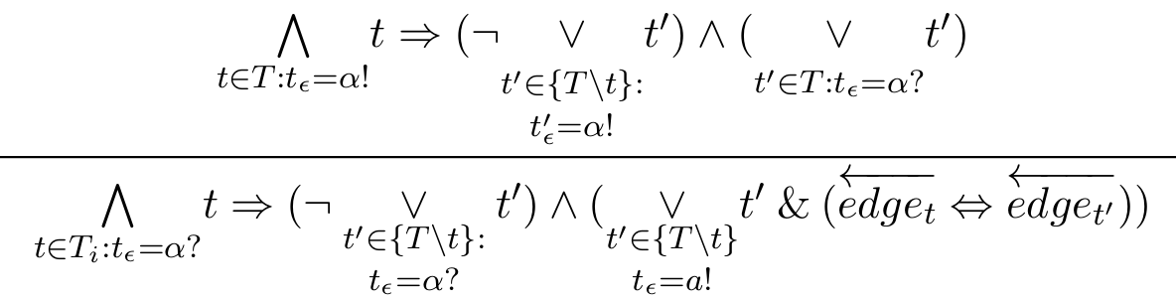
Constraints: Sync
One-to-one sync over a given channel (α)
Two actions: send (!) and receive (?)

Slide 8
Results
Compared against original TACK and MITLBMC
Benchmarks represent real-world applications
Fischer Mutual Exclusion
Carrier Sense Multiple Access / Collision Detection
Token Ring
Tested with varying model size and time bound
Average memory consumption: 20-200MB

Slide 9
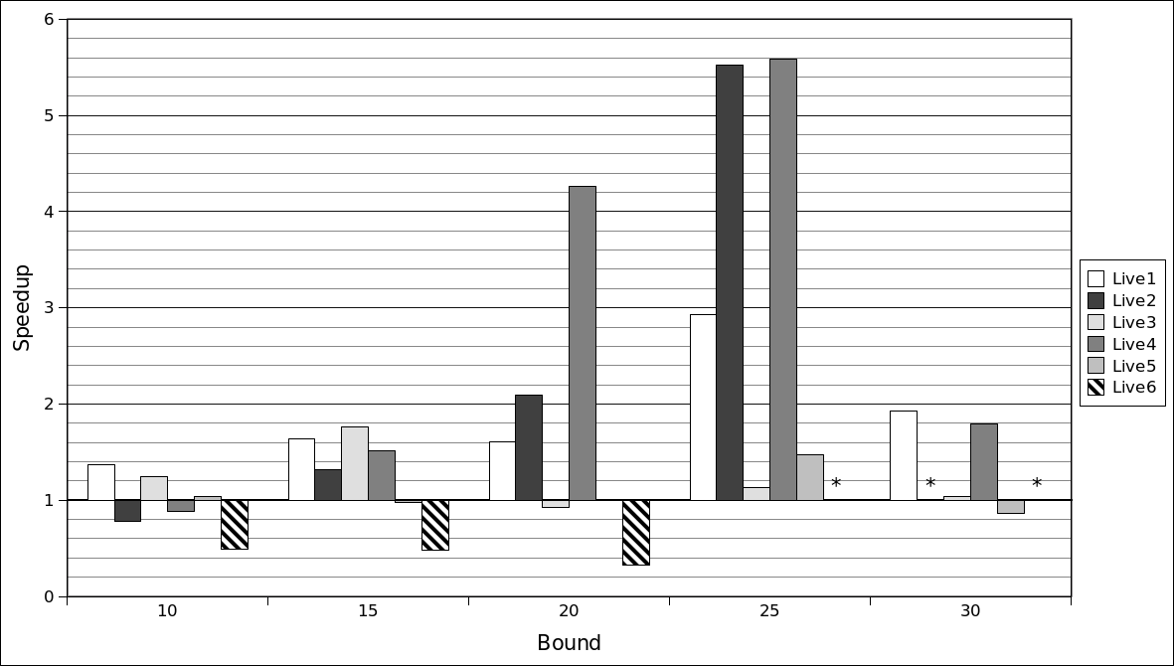
Fischer – average per bound

Slide 10
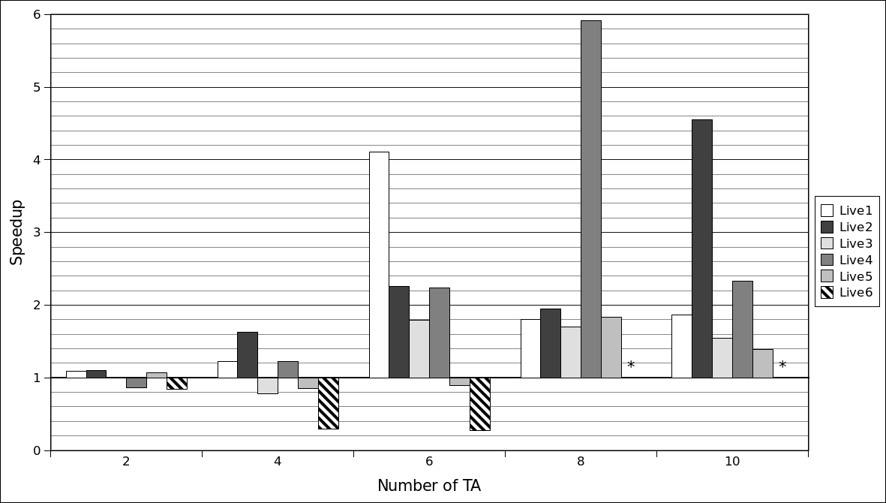
Fischer – average per network size

Slide 11
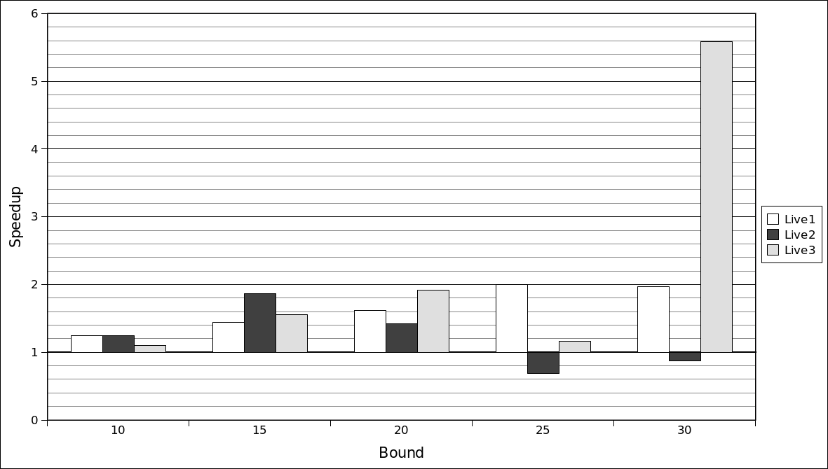
CSMA – Comparison of Different TACK Options

Slide 12
Conclusions
New encoding for network of Timed Automata
Faster performance, better scaling to large networks and high bounds
More options supported for end users

Slide 13
Future Work
Internals:
Similarly re-encode MITL property
“Super-Dense” semantics
Ease-of-Use:
Automatically verify variable bounds
Support for TA templates in input file

Slide 14
Improved Verification of Networks of Timed Automata
Robert Lawrence Smith

